Slide 1

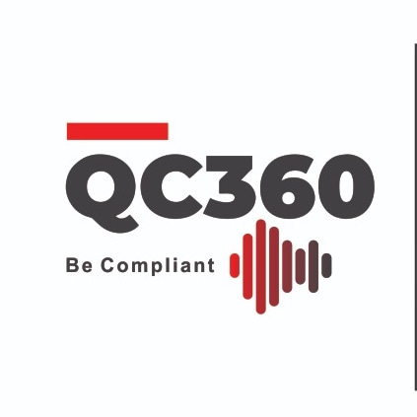
Java with Spring Week 01-A
Instructor : Dr. Saif Ur Rehman
Lab Engineer: Muhammad Hassan Mujtaba

Slide 2

Java With Spring
Java is known for reliability, maintainability, and ease of development
Participants gain extensive hands-on experience writing, compiling, and executing Java programs.
They will learn to build robust web applications that use Java’s object-oriented and functional features.

Slide 3
Course Contents- Week01
Learn about how to setup JDK on a local machine
Pick some integrated development environment (IDE).
Understand the basic syntax of Java with some examples.
Installation
JDK 8 installation
IDE installation
Java Basics
Data Types
Arrays
Operators
Methods
String
Lab

Slide 4
Course Contents- Week02
Understand the concept of version control
What are the commands of GIT version control, and how its useful in the software industry
Git
Installation
Pull and push
Resolve conflict
Lab

Slide 5
Course Contents- Week03
To understand the fundamental concepts of OOP
Java in the light of Object Oriented
Classes and Object
Fields and Access Control
Constructor and overloaded Constructor
this and super keyword
Abstraction
Interface
Inheritance
Polymorphism
Override vs Overload
Exception Handling
Generics
Lab

Slide 6
Course Contents- Week04
Touch the advanced concept of OOP which is called Design pattern.
In software engineering, a design pattern is a general repeatable solution to a commonly occurring problem in software design.
Design Patterns
What is Design Pattern
Singleton Design Pattern
Adaptor Design Pattern
Chain Of Responsibility
Lab

Slide 7
Course Contents- Week05
we will cover some data structures which are already programmed in Java Collection, and last we will see how to debug our program in order to catch the bug on a specific line.
Java Collections
Array List
Link List
Set
Queue
Stack
Map
Lab

Slide 8
Course Contents- Week06
To learn what is Multithreading and how it works in java.
We will also cover the network programming by making a Chat Application.
Java Sockets and Threads
Multithreading
Java Socket with Chat App
Lab

Slide 9
Course Contents- Week07
Exploring Java I/O File to read and write Text Files
File handling
Write File
Read File
Map file data with Object Class
Lab

Slide 10
Course Contents- Week08
From Java 8 onward, the Functional Paradigm has been included in the form of lambda expressions.
Java 8
Philosophy of Functional Programming
Lambda Expressions
Functional Interface
Lab

Slide 11
Course Contents- Week09
We will learn the Architecture diagram of N-tire Application.
Web Development Echo System
N tier Application

Slide 12
Course Contents- Week10
To learn Web development & understand what a Web Server is and how to install & configure it
Learning Port & servlet and how to deploy my code into Server?
Web Server
Tomcat installation and Configuration
Java Servlets and filters
Servlet and its life Cycle
Filter Chain
Configuration via XML and Annotation
HTTP Request vs HTTP Response - Session & Cookie
Deploy war file into Tomcat
Maven and Gradle & LAB

Slide 13
Course Contents- Week11
Explore the modules of Spring.
Different Methods of configure Spring
Spring Core
Spring Introduction
Spring Bean by programmatically, XML and Annotation
Bean life cycle & Scope
Dependency Injection
Configuration XML vs Annotations
Aspect Oriented Programming
Property file vs YML file
LAB

Slide 14
Course Contents- Week12
We will focus on fundamentals of the spring web module.
To explore how server will entertain the user request and forward his/her request to database and after some processing this request will get back to user as response
Spring Web
Spring Http servlet
Spring Filter
Spring MVC Thymeleaf
Spring JDBC

Slide 15
Course Contents- Week13
Spring Boot makes it easy to create stand-alone, production-grade Spring based Applications that you can "just run".
Spring Boot
Spring Initializer (Web+CLI)
Run Spring Boot Project with Embedded Tomcat Server
Run Spring Boot Project with Jetty Server

Slide 16
Course Contents- Week14
To extend Spring Boot towards Web Application Development
Spring Boot Web
Frontend in HTML,CSS,JS
Rest API
Service Layer
File Interaction
Lab

Slide 17
Course Contents- Week15
We will learn how Spring boot interacts with different databases.
Database Connectivity
Hibernate
Spring JPA
Spring MongoDB
Lab

Slide 18
Course Contents- Week16
Security is an essential factor for every application.
Spring boot provides the security module with a list of specifications.
Spring Security
Authentication through JWT Token
Authorization through Database
Lab

Slide 19
Course Contents- Week17
Caching is a part of temporary memory (RAM). It lies between the application and the persistence database. Spring boot also provides the APIs regarding cache also we will learn what is spring batch and how it works
Cache Management
Spring Cache
Spring Batch
Lab

Slide 20
Learning Outcomes
Implement syntax rules in Java programs.
Transform the real world object into Object oriented world
Functional Programming
Multithreading
Use data structure techniques
How to use Git
Get an overview of N-tier Application
Get an overview of Web Development with Spring Echo System

Slide 21

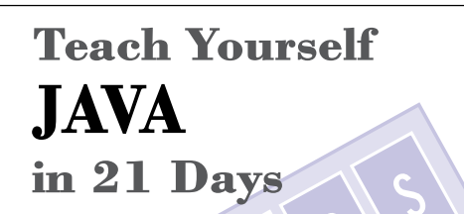
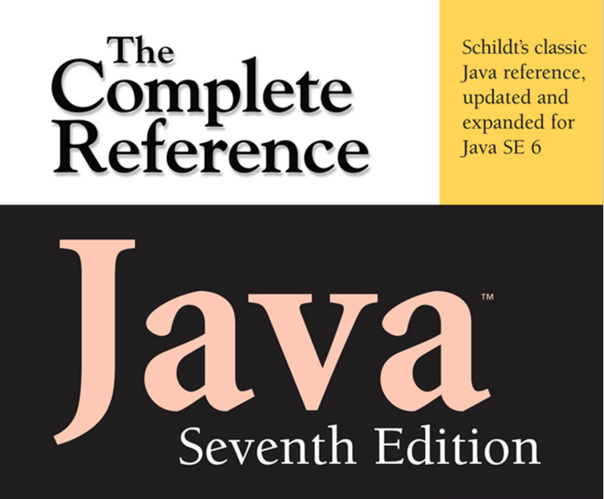
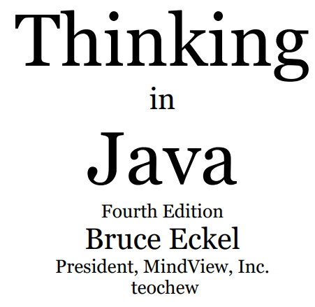


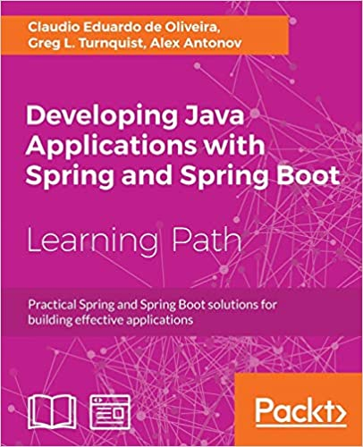
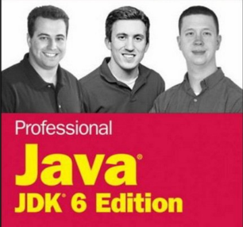
Recommended Books

Slide 22
Online Sources
https://www.learnjavaonline.org/
https://www.codecademy.com/learn/learn-java
https://www.udemy.com/topic/spring-framework/
https://www.youtube.com/watch?v=4EmQNuc7tPA&list=PLoXwygpUa4moJYTGUxOGVRuVRcFYVJCCL

Slide 23




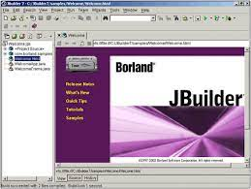

Java - IDE

Slide 24
Learning Outcomes
Implement syntax rules in Java programs.
Transform the real world object into Object oriented world
Functional Programming
Multithreading
Use data structure techniques
How to use Git
Get an overview of N-tier Application
Get an overview of Web Development with Spring Echo System

Slide 25
Course Contents- Week01
Learn about how to setup JDK on a local machine
Pick some integrated development environment (IDE).
Understand the basic syntax of Java with some examples.
Installation
JDK 8 installation
IDE installation
Java Basics
Data Types
Arrays
Operators
Methods
String
Lab

Slide 26
Java
Java is a high-level, general-purpose, object-oriented, and secure programming language developed by James Gosling at Sun Microsystems, Inc. in 1991.
It is formally known as OAK.
In 1995, Sun Microsystem changed the name to Java.
Java runs on a variety of platforms, such as Windows, Mac OS, and the various versions of UNIX
On 13 November, 2006, Sun released much of Java as free and open source software under the terms of the GNU General Public License (GPL).
In 2009, Sun Microsystem takeover by Oracle Corporation.

Slide 27
Java
Java is related to C++, which is a direct descendant of C.
Much of the character of Java is inherited from these two languages.
From C, Java derives its syntax. Many of Java’s object-oriented features were influenced by C++.
The Java designers knew that using the familiar syntax of C and echoing the object-oriented features of C++ would make their language appealing to the legions of experienced C/C++ programmers.

Slide 28

Java
The reach and power of Java continues to be felt in the world of computer language development.
Many of its innovative features, constructs, and concepts have become part of the baseline for any new language. The success of Java is simply too important to ignore.
Perhaps the most important example of Java’s influence is C#, Created by Microsoft to support the .NET Framework, C# is closely related to Java.
For example, both share the same general syntax, support distributed programming, and utilize the same object model.
There are, of course, differences between Java and C#, but the overall “look and feel” of these languages is very similar.

Slide 29
Why Learn Java?
Java is a MUST for students and working professionals to become a great Software Engineer specially when they are working in Software Development Domain. Advantages included
Object Oriented
Platform Independent
Simple
Secure
Architecture-neutral
Portable
Notes:
Object Oriented − In Java, everything is an Object. Java can be easily extended since it is based on the Object model.
Platform Independent − Unlike many other programming languages including C and C++, when Java is compiled, it is not compiled into platform specific machine, rather into platform independent byte code. This byte code is distributed over the web and interpreted by the Virtual Machine (JVM) on whichever platform it is being run on.
Simple − Java is designed to be easy to learn. If you understand the basic concept of OOP Java, it would be easy to master.
Secure − With Java's secure feature it enables to develop virus-free, tamper-free systems. Authentication techniques are based on public-key encryption.
Architecture-neutral − Java compiler generates an architecture-neutral object file format, which makes the compiled code executable on many processors, with the presence of Java runtime system.
Portable − Being architecture-neutral and having no implementation dependent aspects of the specification makes Java portable. Compiler in Java is written in ANSI C with a clean portability boundary, which is a POSIX subset.
Robust − Java makes an effort to eliminate error prone situations by emphasizing mainly on compile time error checking and runtime checking.

Slide 30
Editions of Java
Java Standard Editions (JSE): It is used to create programs for a desktop computer.
Java Enterprise Edition (JEE): It is used to create large programs that run on the server and manages heavy traffic and complex transactions.
Java Micro Edition (JME): It is used to develop applications for small devices such as set-top boxes, phone, and appliances.

Slide 31
Types of Java Applications
Standalone Applications
Enterprise Applications
Web Applications:
Mobile Applications
Notes:
Standalone Applications: Java standalone applications uses GUI components such as AWT, Swing, and JavaFX. These components contain buttons, list, menu, scroll panel, etc. It is also known as desktop alienations.
Enterprise Applications: An application which is distributed in nature is called enterprise applications.
Web Applications: An applications that run on the server is called web applications. We use JSP, Servlet, Spring, and Hibernate technologies for creating web applications.
Mobile Applications: Java ME is a cross-platform to develop mobile applications which run across smartphones. Java is a platform for App Development in Android.

Slide 32
Java Development Kit - JDK
The Java Development Kit (JDK) is a cross-platform software development environment
It includes the Java Runtime Environment (JRE), an interpreter/loader (Java), a compiler (javac), an archiver (jar), a documentation generator (Javadoc), and other tools needed in Java development.
Offers a collection of tools and libraries necessary for developing Java-based software applications and applets.
It is a core package used in Java, along with the JVM (Java Virtual Machine) and the JRE (Java Runtime Environment).

Slide 33
Java Runtime Environment - JRE
A Java™ runtime environment (JRE) is a set of components to create and run a Java application.
A JRE is part of a Java development kit (JDK).
A JRE is made up of a Java virtual machine (JVM), Java class libraries, and the Java class loader.

Slide 34
Java Virtual Machine - JVM
A specification where the working of Java Virtual Machine is specified. But implementation provider is independent to choose the algorithm. Its implementation has been provided by Sun and other companies.
An implementation is a computer program that meets the requirements of the JVM specification.
Runtime Instance Whenever you write a java command on the command prompt to run the java class, an instance of JVM is created.

Slide 35
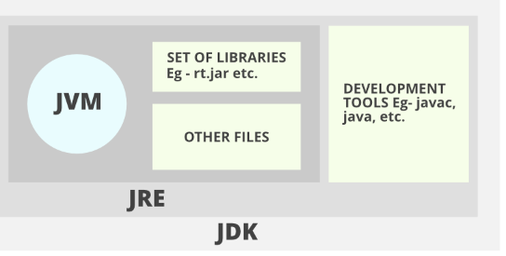
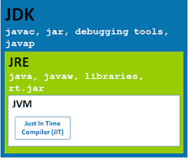
JDK, JVM and JRE

Slide 36
Java Program Structure
A specification where the working of Java Virtual Machine is specified. But implementation provider is independent to choose the algorithm. Its implementation has been provided by Sun and other companies.
An implementation is a computer program that meets the requirements of the JVM specification.
Runtime Instance Whenever you write a java command on the command prompt to run the java class, an instance of JVM is created.

Slide 37
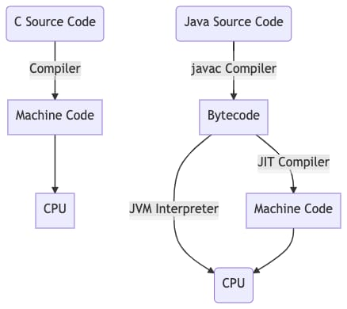
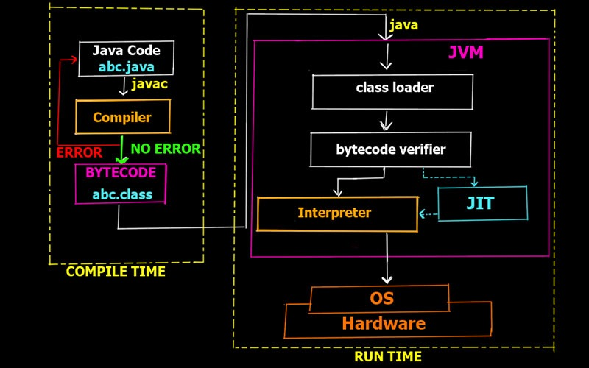
C++ Vs Java

Slide 38
Installation – JDK 8
Download Link: https://www.oracle.com/java/technologies/javase/javase8u211-later-archive-downloads.html
Note:
Open this link to download JDK(Java Development kit)

Slide 39
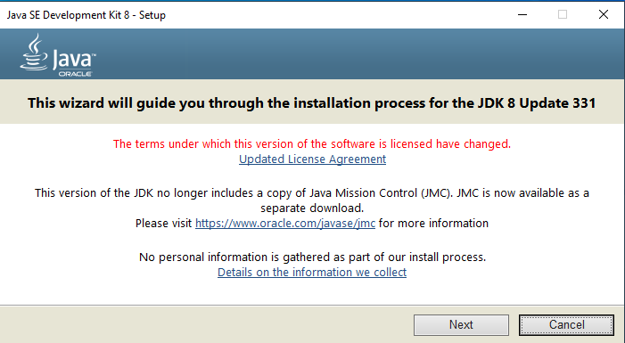
JDK-8 Installation

Slide 40
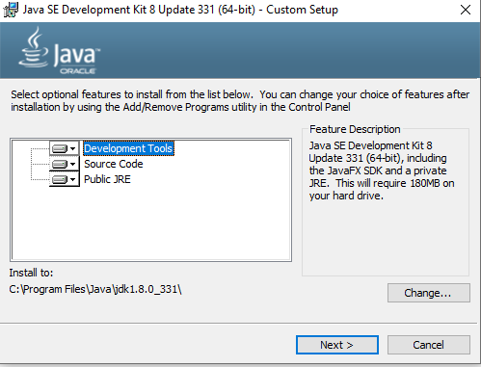
JDK-8 Installation

Slide 41
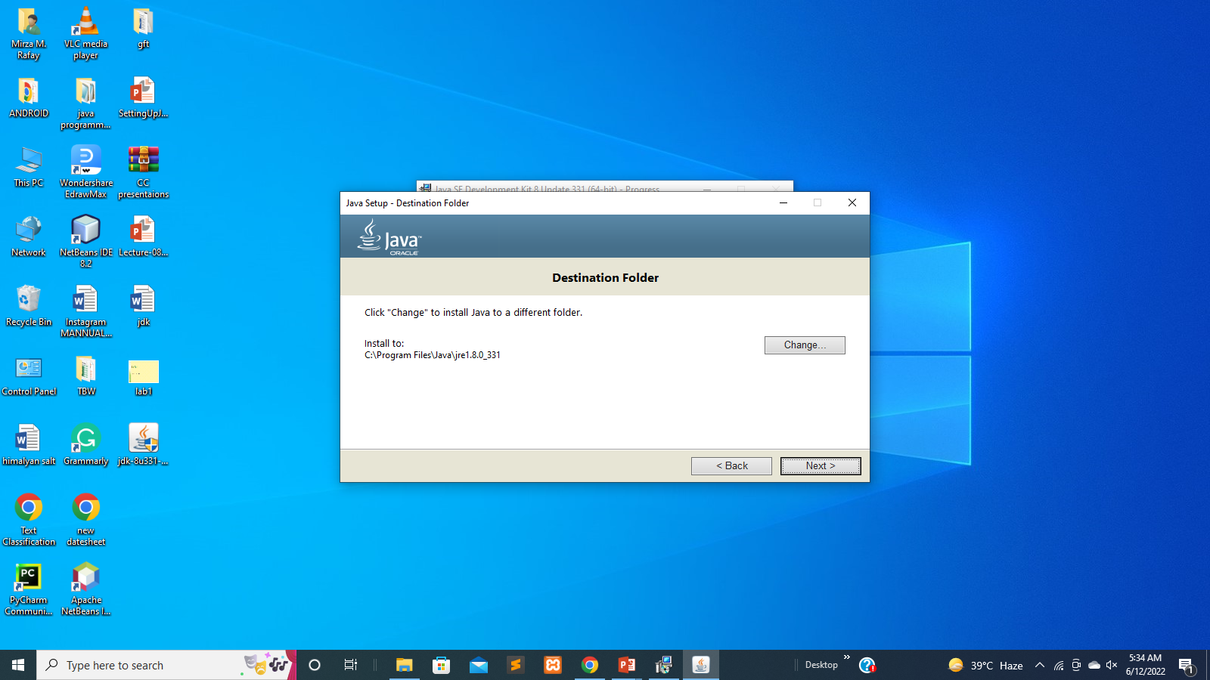
JDK-8 Installation

Slide 42
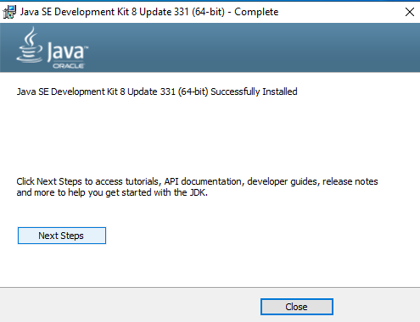
JDK-8 Installation

Slide 43
JDK-8 Installation
An integrated development environment is a software application that provides comprehensive facilities to computer programmers for software development.
An IDE normally consists of at least a source code editor, build automation tools
Most popular Java IDE is Netbeans, so we will guide you about downloading and installing java Netbeans.

Slide 44
NetBeans Installation
Download Link: https://netbeans.apache.org/download/nb13/nb13.html
Note
Open this link to download JDK(Java Development kit)

Slide 45
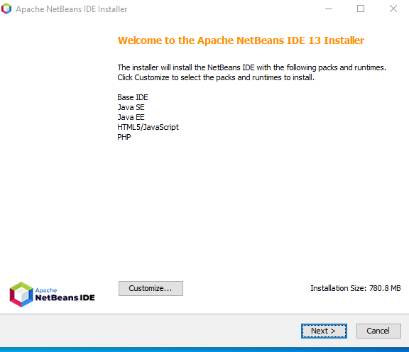
NetBeans Installation

Slide 46
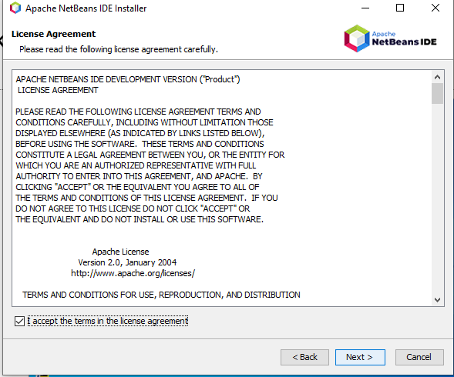
NetBeans Installation

Slide 47
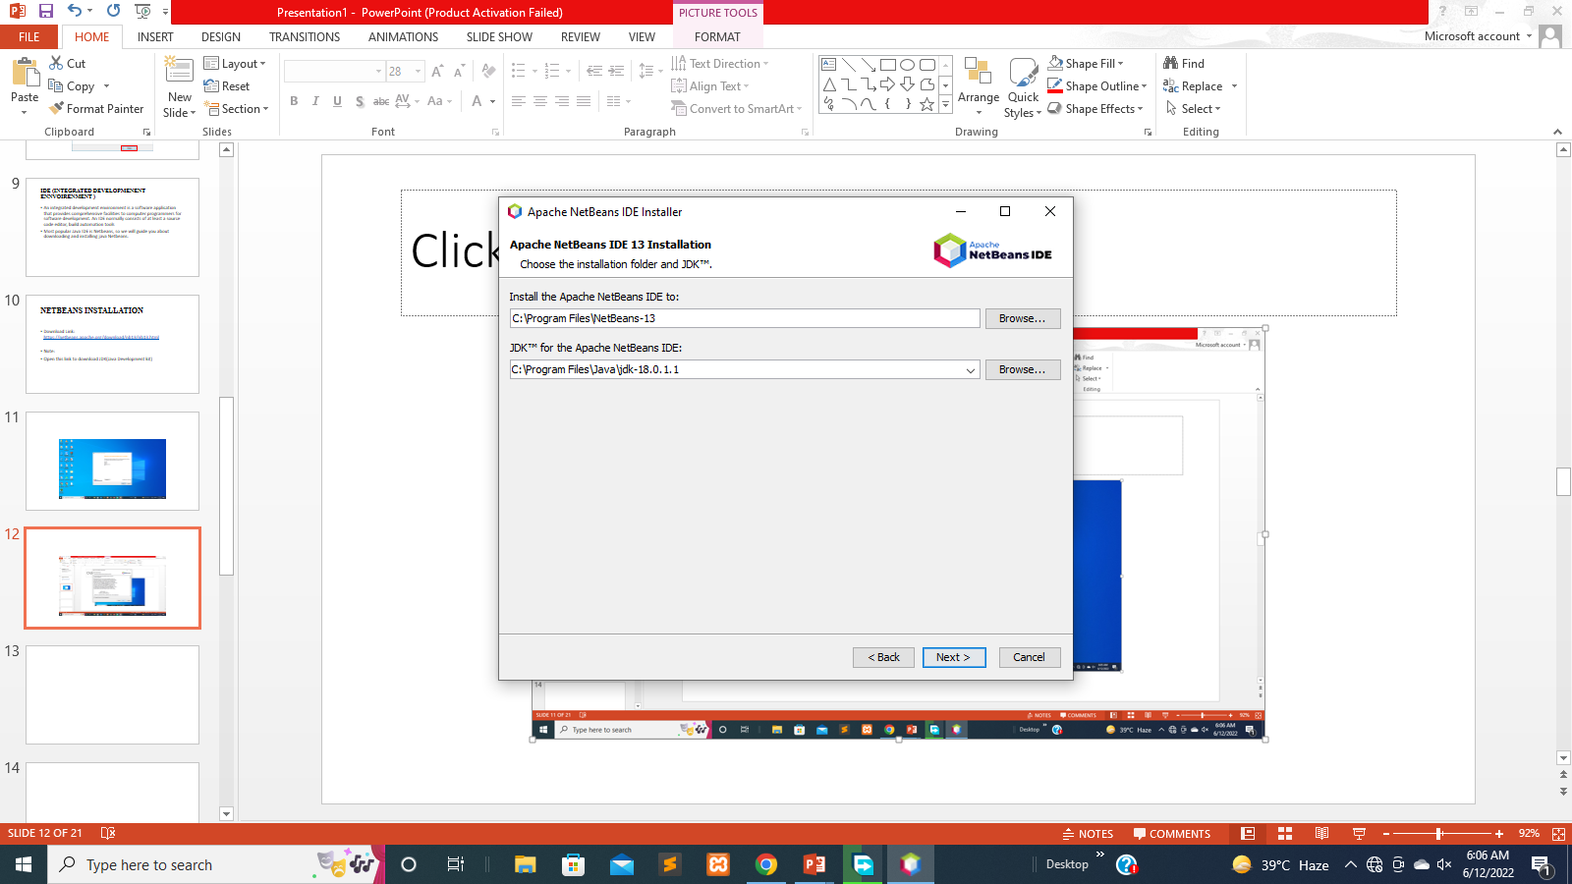
NetBeans Installation

Slide 48
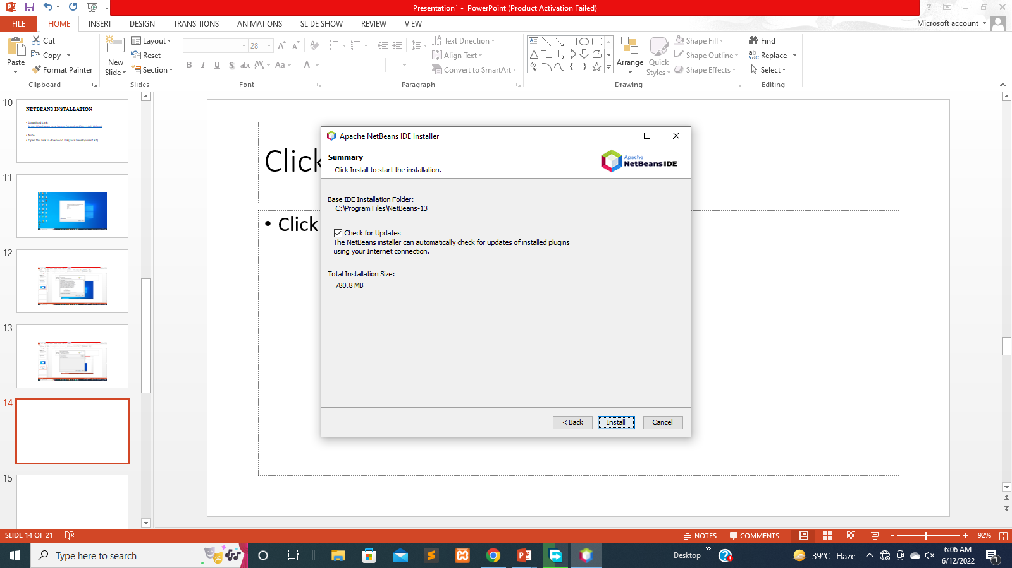
NetBeans Installation

Slide 49
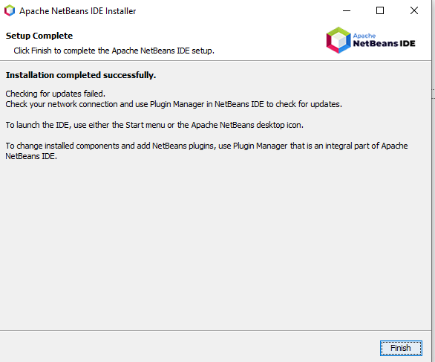
NetBeans Installation

Slide 50
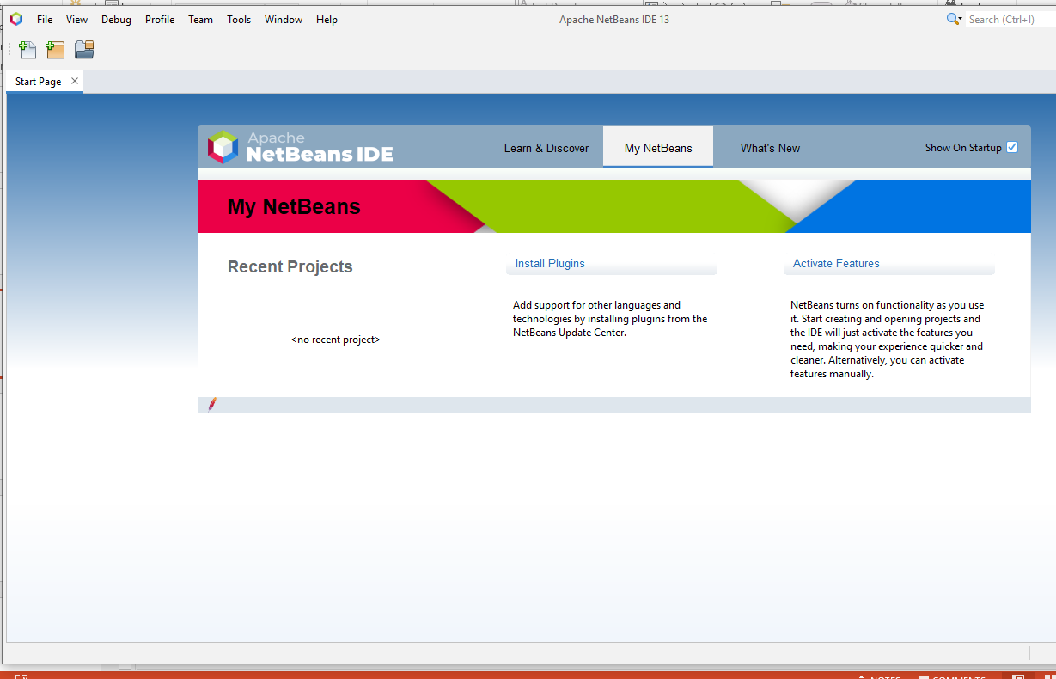
NetBeans Installation

Slide 51
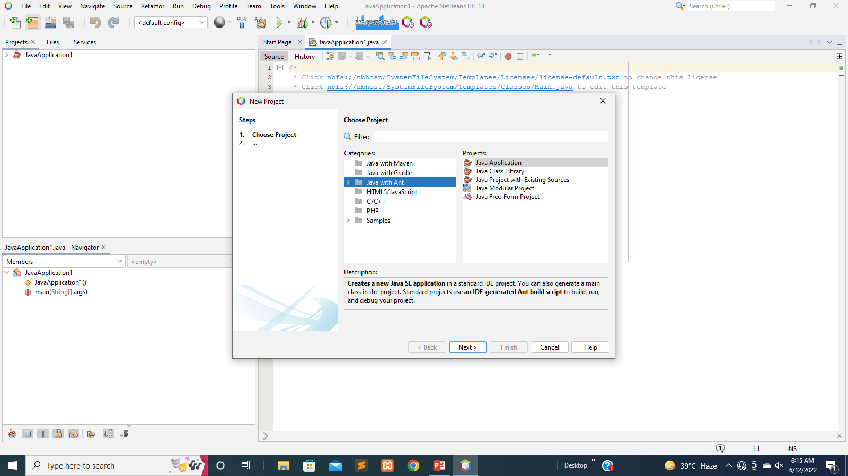
NetBeans Installation

Slide 52
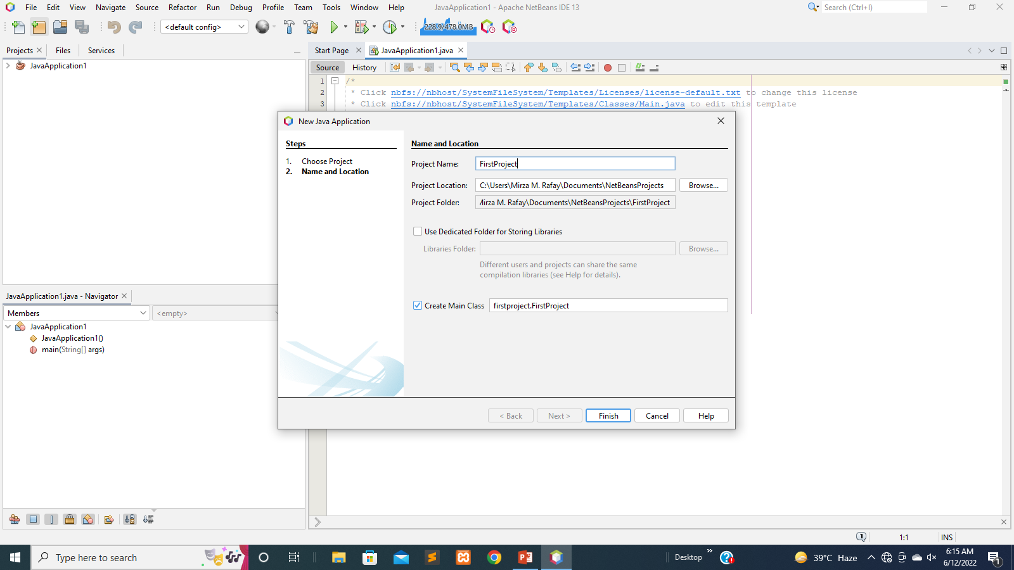
NetBeans Installation

Slide 53
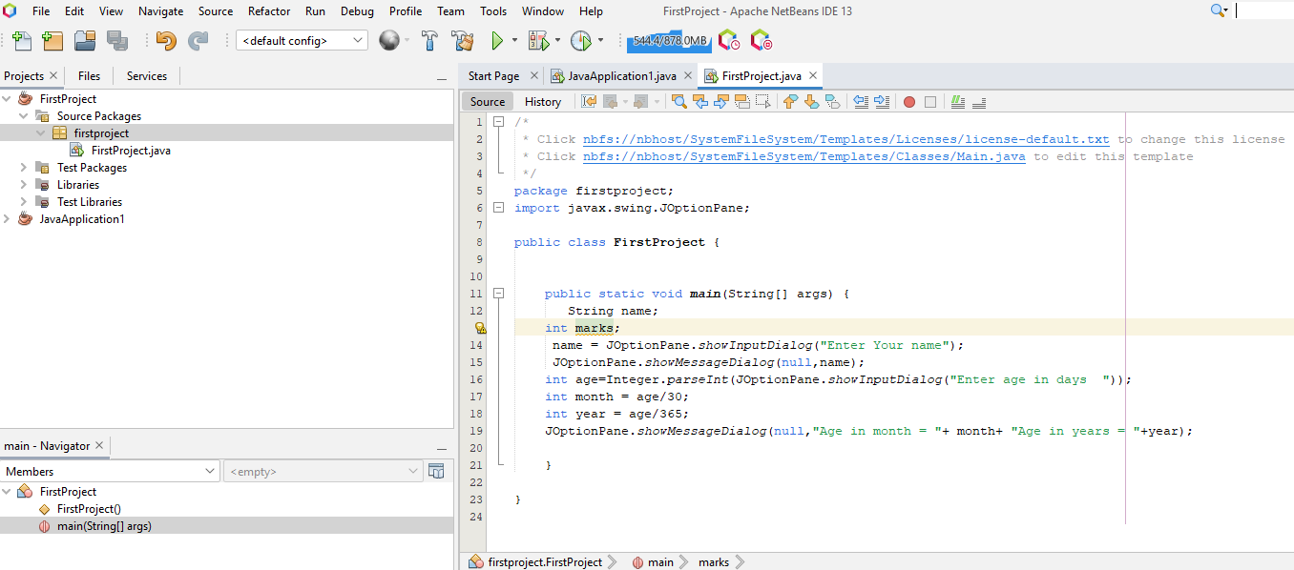
Input Box & Message Box

Slide 54
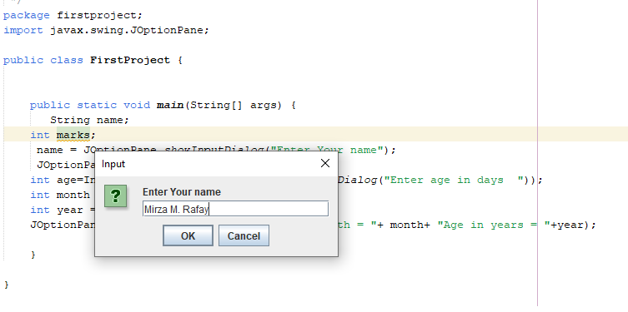
Input Box & Message Box

Slide 55
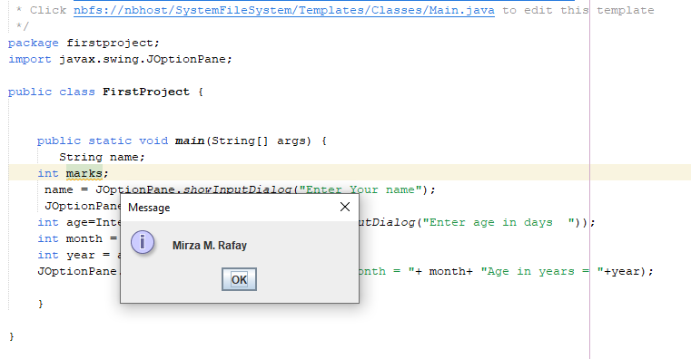
Input Box & Message Box

Slide 56
Assignment
What are the main differences between 1st , 2nd , 3rd and 4th generation programming languages
List down 1st , 2nd , 3rd and 4th generation programming languages

Slide 57
Any Question
THANK YOU ☺

